Slide 1

S- Board
Presented By:
JAYA SAI KRISHNA MUPPALLA
KRISHNA CHAITANYA NALLURI
SAI RAHUL PAVULURI
NAVEEN KUMAR MIRYALA

Slide 2
Introduction
The main aim of this project is to regulate all the In-class activities by the students through an online service.
Using our system the student can discuss their doubts through the chat application.
The professor can post the Assignments, Quizzes and also check the student involvement in the In-Class activites.

Slide 3
IDEA
Building a system that enables the communication among students of a class.
A platform for the teachers to know more regarding the class participation of the students.
Evaluate the performance of the students in the courses.

Slide 4
Working Model
A chat application is created through which the students can create a chat group so that they can discuss regarding the queries and assignments.
Using Proprofs, we had designed the way such that professor can post the quizzes online.

Slide 5
Working Model(Contd.)
All the details like the score reports, name of the student, ip address are stored in the database.
We used the external web services such the Google maps and weather so as to know the directions.

Slide 6
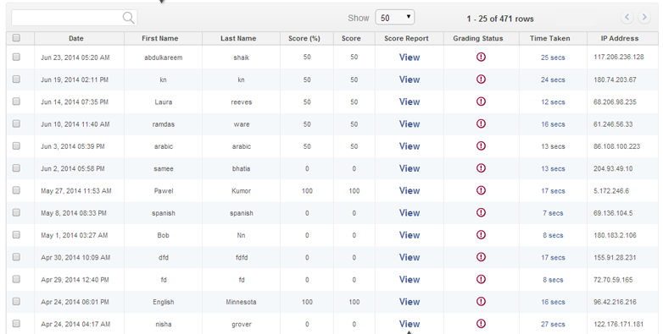
Databse of Quiz

Slide 7
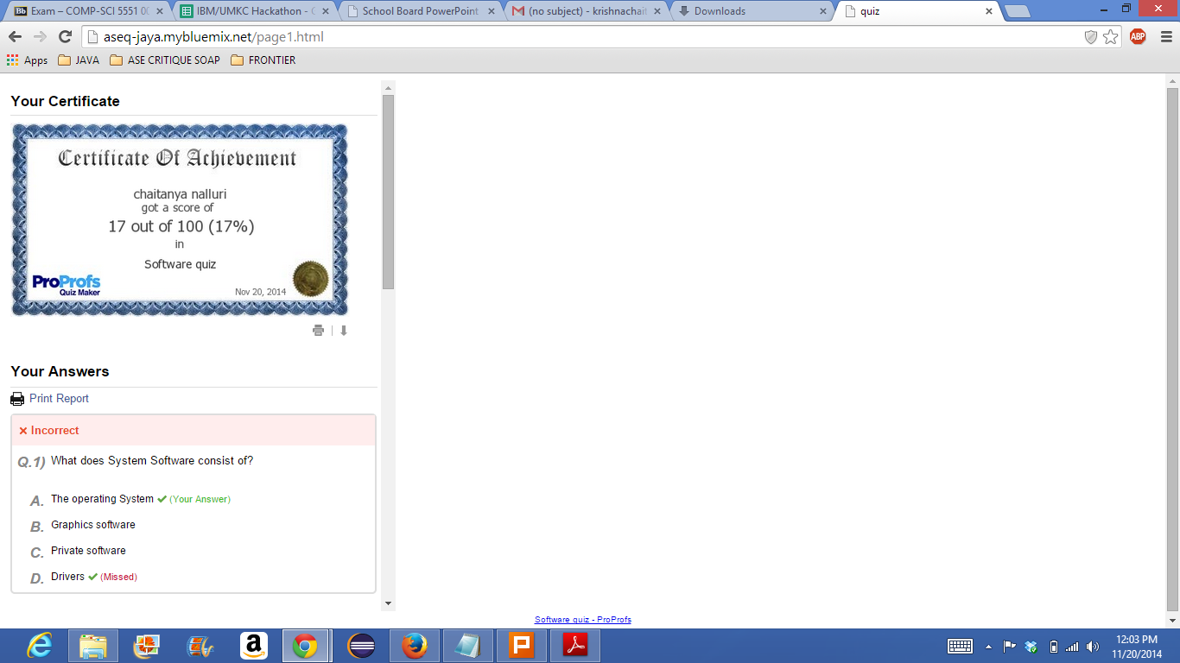
Quiz Report

Slide 8


